Slide 1
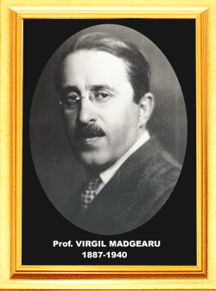
Virgil Madgearu
The 19th EPMeeting, Iasi
Bianca Brisca
bianca_brisca@icloud.com
Catalina Fratila
catuza97@yahoo.com
Irina Munteanu irina_deni@yahoo.com
Virgil Madgearu
Economic College
www.madgearu.ro
cemadgearu@yahoo.com
Important Romanian personality
in economic sciences, sociology and politics

Slide 2
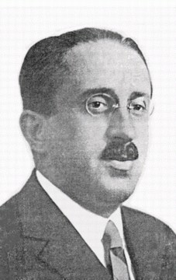
General biography
Virgil Traian Madgearu was born on the 14th of December 1887 and he died on the 27th of November 1940.
He was a Romanian economist having important activity as an essay-writer and journalist.

Slide 3
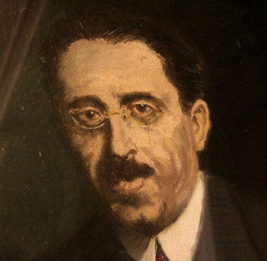
A Highly Reputed Professor !
As a highly reputed professor, Virgil Madgearu paid a special attention to the training of the students, organizing and leading courses for the doctor’s degree in economic sciences .

Slide 4
Impressive Work and Importance !
He contributed to the formation of economists for the practical activity in enterprises, for state administration, for education and scientific research.
His work impresses us today, by the variety of its topics, as well as by the vast and solid documentation.

Slide 5
Principles.Concepts. Methods.
Firstly, for him a university course implies a conception, a method and systematic plan of dealing with the problems.
This methodologic principle was respected in all his courses.
He brought a real contribution to the formulation of certain notions, concepts and economic categories.

Slide 6
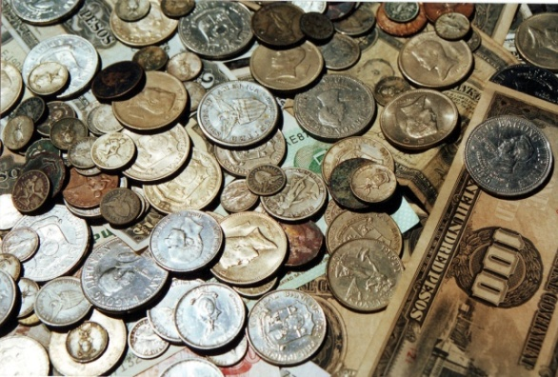
Definitions, Notions & Categories
One of his concepts was the definition of the political economy considered as a science which deals with the rules governing : production, circulation, distribution and the consumption of material goods.
Such notions and categories as :
value
accumulation of capital
price
profit

Slide 7
We must remember :
His progressive and democratic views and principles.
His ferm antifascist stand.
His tireless fight for the economic independence of the country under the conditions of the historical period which preceded the second World War.

Slide 8
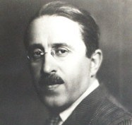
What Virgil Madgearu represents for our country ?
Virgil Madgearu represents in the history of economic science: one of the founders of the high economic education and organizer of the social economic research in Romania.
Above all he was an explorer and a distinguished university professor.

Slide 9
Virgil Madgearu : An important value
Murdered by the fascists in 1940, while he was still in full power of creation, professor V. Madgearu left behind him a rich and valuable economic work, the result of a tireless activity, of a talented and upright professor of high reputation.

Slide 10
Selected Works
"On the Economic Evolution of Romania“- 1911
"Economic Dictatorship or Economic Democracy?“-1925
Romania's New Economic Policy -1930
"Our Technical Collaboration With the League Of Nations“-1933
"The Development Of Romanian Economy After World War I“-1940

Slide 11
Ecce tempus!
It’s time!
Created in 1966, “V. Madgearu” Economic College changed significantly in the course of time. It prepared many generations for life difficulties and it gained a well-deserved prestige.

Slide 12
Today it is proudly named by one of the most important politician and economist, Virgil Madgearu who set up the basis of the modern Romanian economical education.

Slide 13
Per aspera ad astra!
Through hardships to the stars!
And due to inheritance to carry on the tradition all who are apart of the big family of “V. Madgearu” Economic College, from students to teachers, they ought to keep and go on its renown.

Slide 14
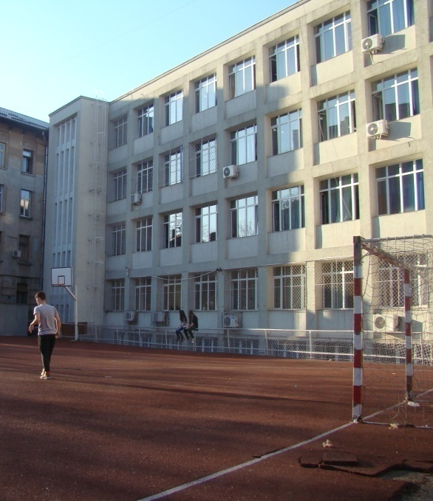
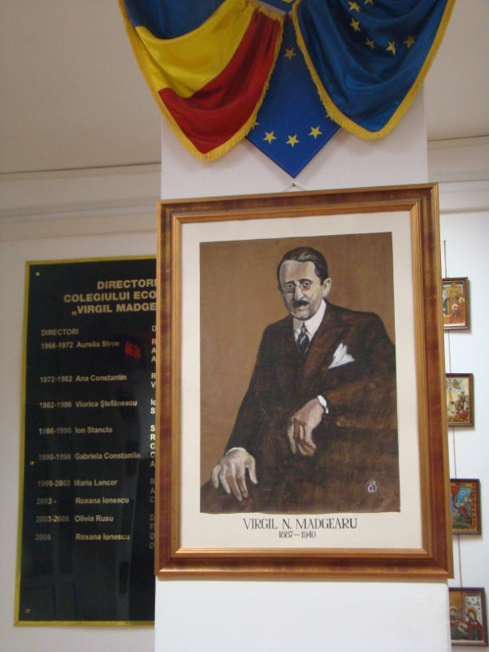
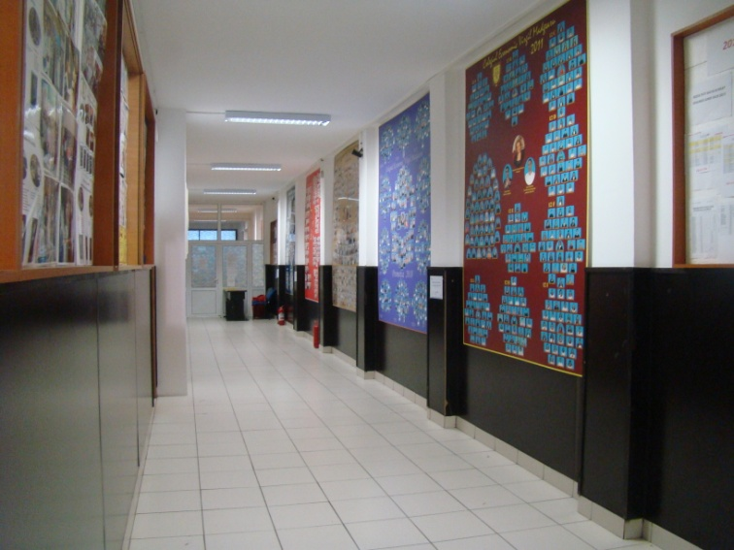
“Virgil Madgearu” Economic College

Slide 15
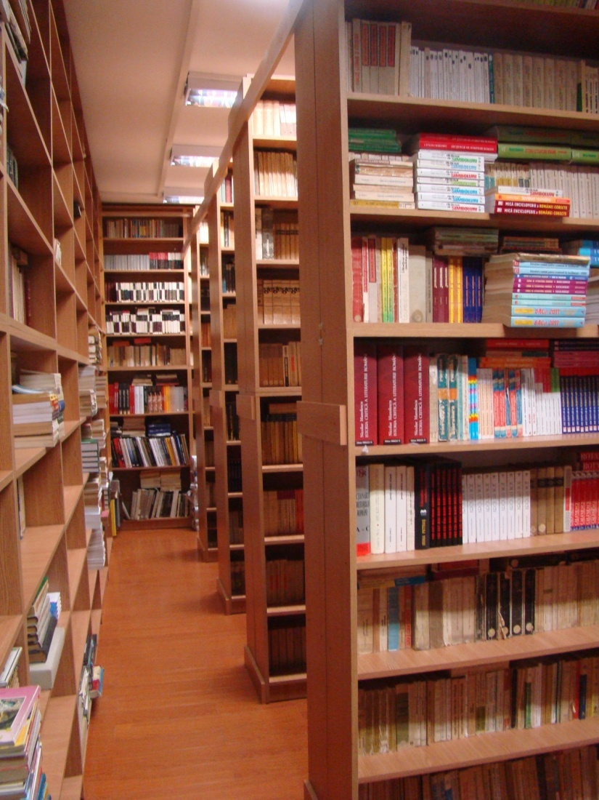
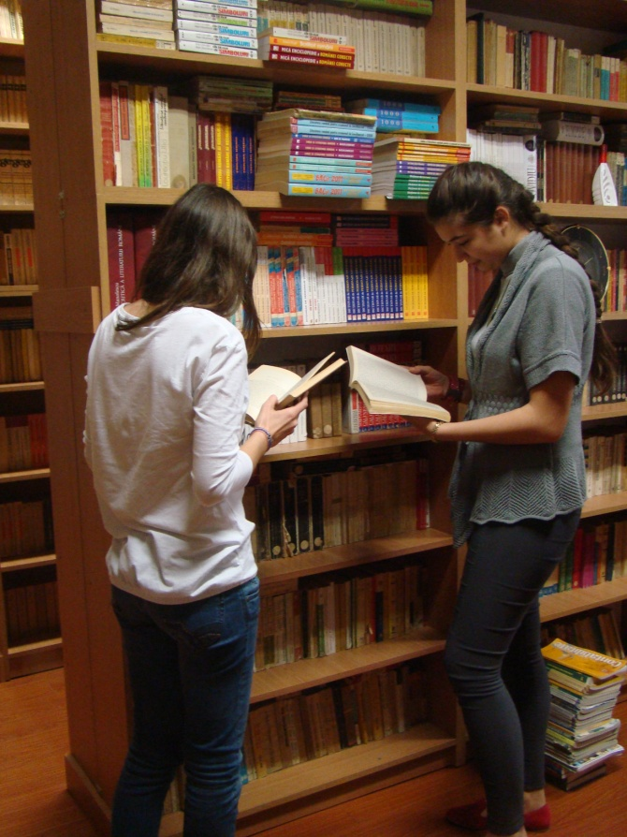

Slide 16
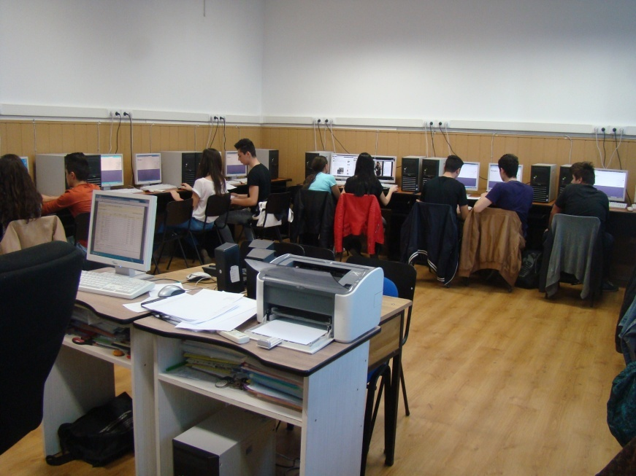
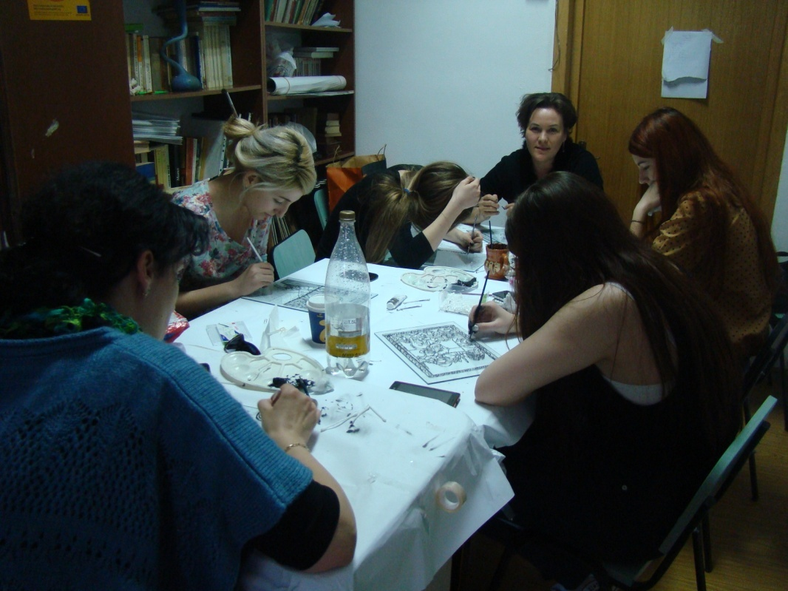
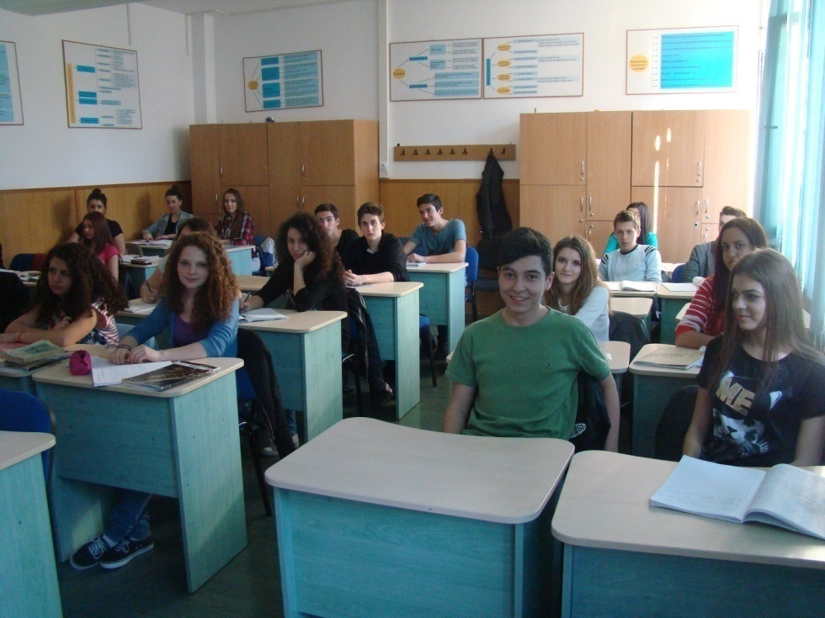

Slide 17
Our school magazine
The school magazine offered us an opportunity to assert ourselves. It gave us trust in our own forces and the hope that even the small things that go through our mind day by day are valuable.

Slide 18
Also, it represents a way to get to know our colleagues better and the teachers who guided us too. The most valuable thing we gained is the experience which will surely be useful in the future.

Slide 19
In our school magazine you find information about school projects, pictures from events, poems and stories written by our students.

Slide 20
Bibliography
“Professor Virgil Madgearu”- V. Malinschi, The Academy of Socialist Republic of Romania, Bucharest, 1975

Slide 21
Thank You!
The project was realized by:
Bianca Elena Brisca bianca_brisca@icloud.com
Catalina Elena Fratila catuza97@yahoo.com
Irina Denisa Munteanu irina_deni@yahoo.com
Coordinator Teacher:
Mariana Schiaua marianaschiaua@rdslink.ro

